Slide 1
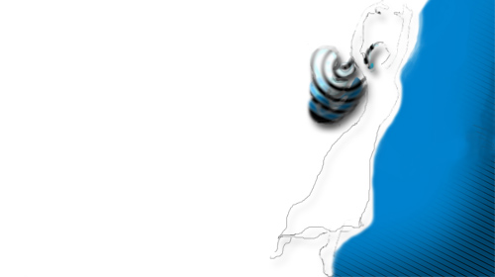
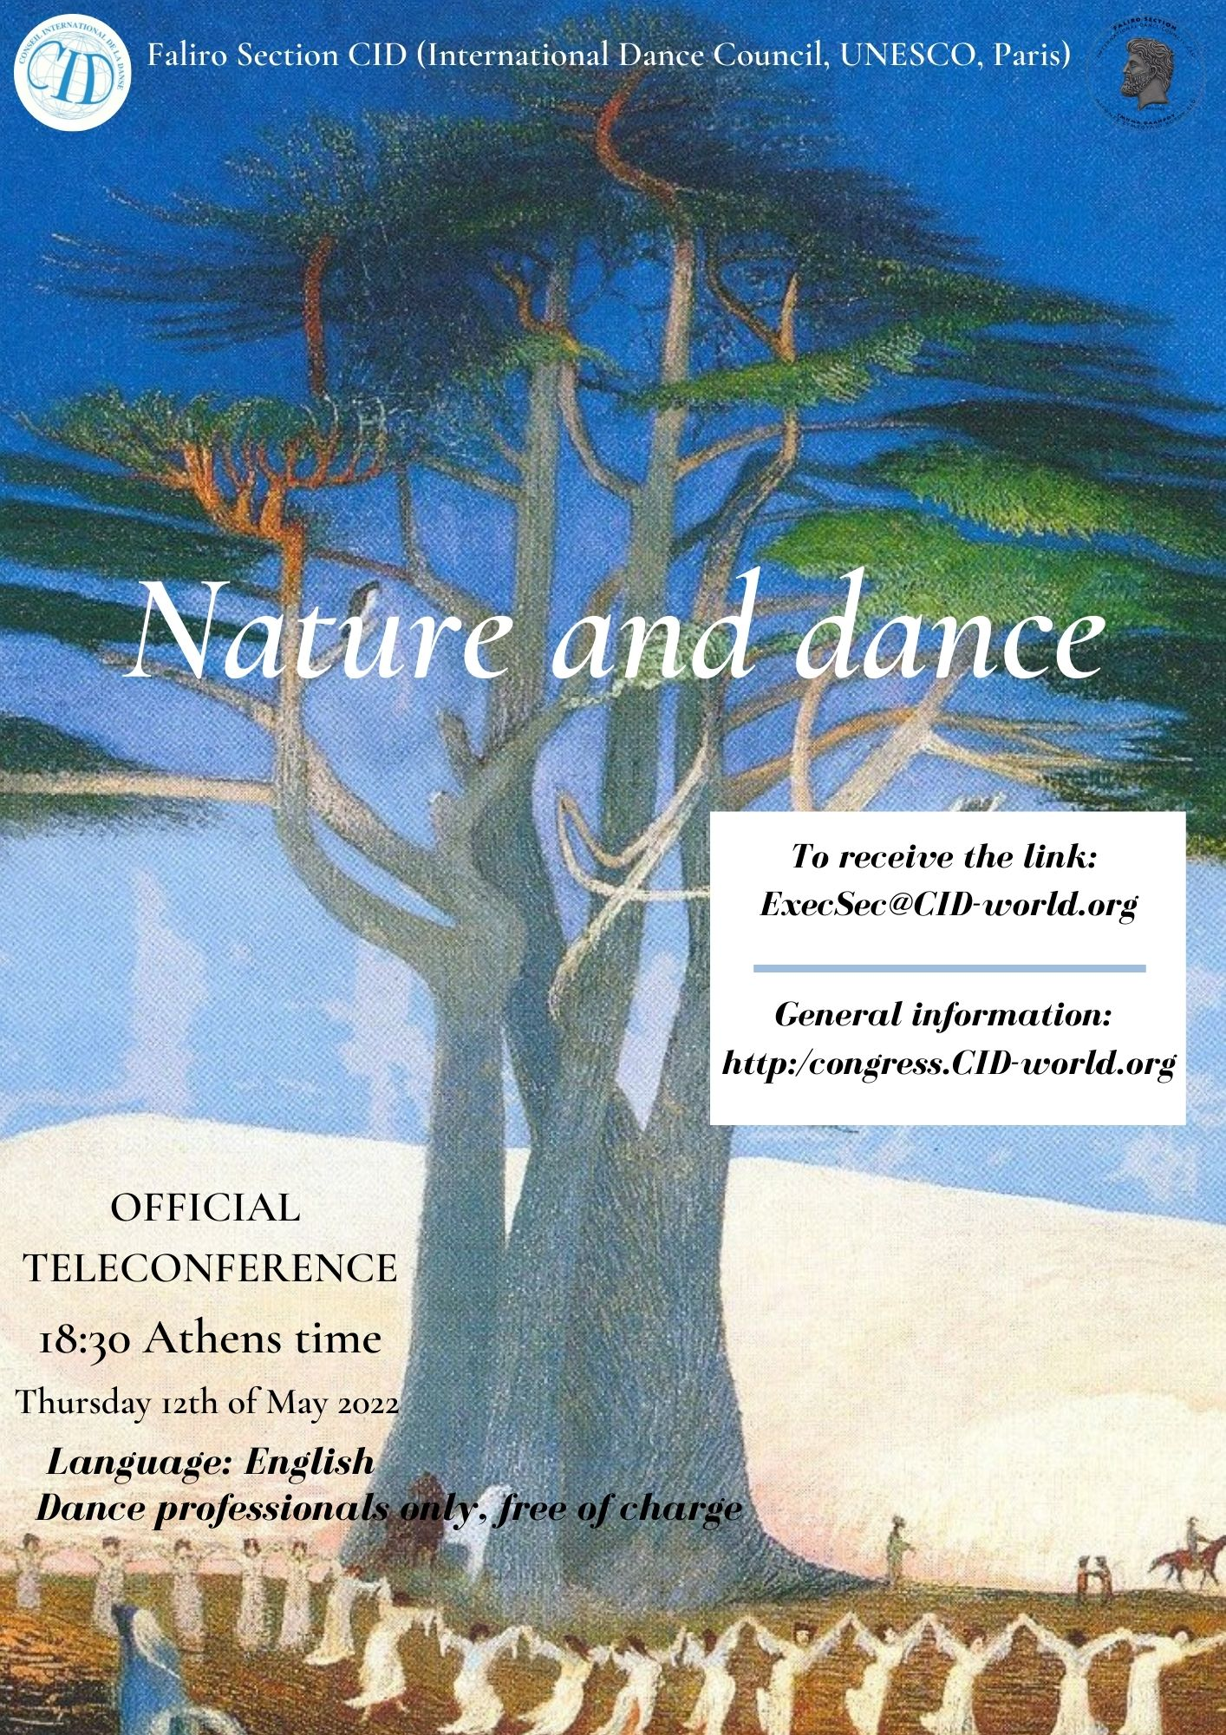
Speaker:
Dr.Iliana Petrova Salazar-
Member of CID UNESCO
Academic dance researcher
Choreographer, Dance teacher
Sofia, Bulgaria
iliana.psdance@gmail.com
Leader of:
“DANCE - Al Art Visions”
alartvisions@gmail.com
www.dance-all.com

Slide 2
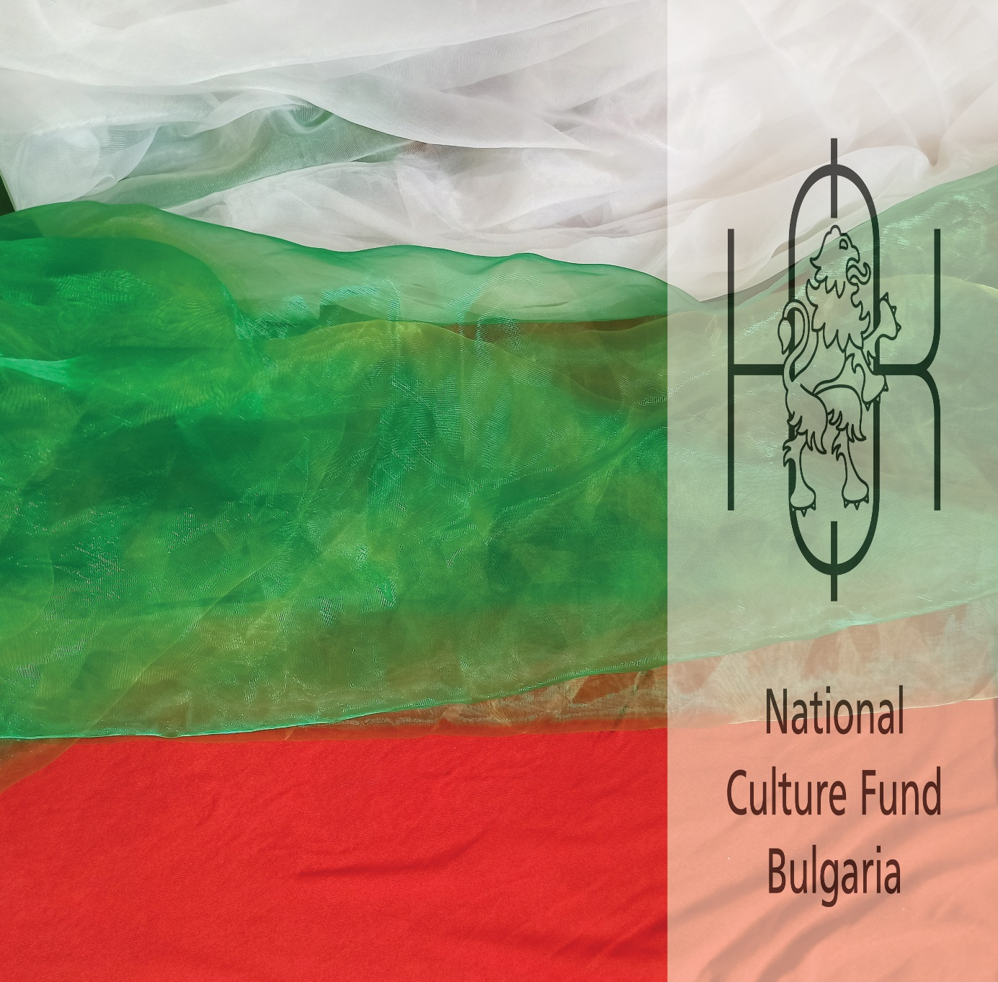
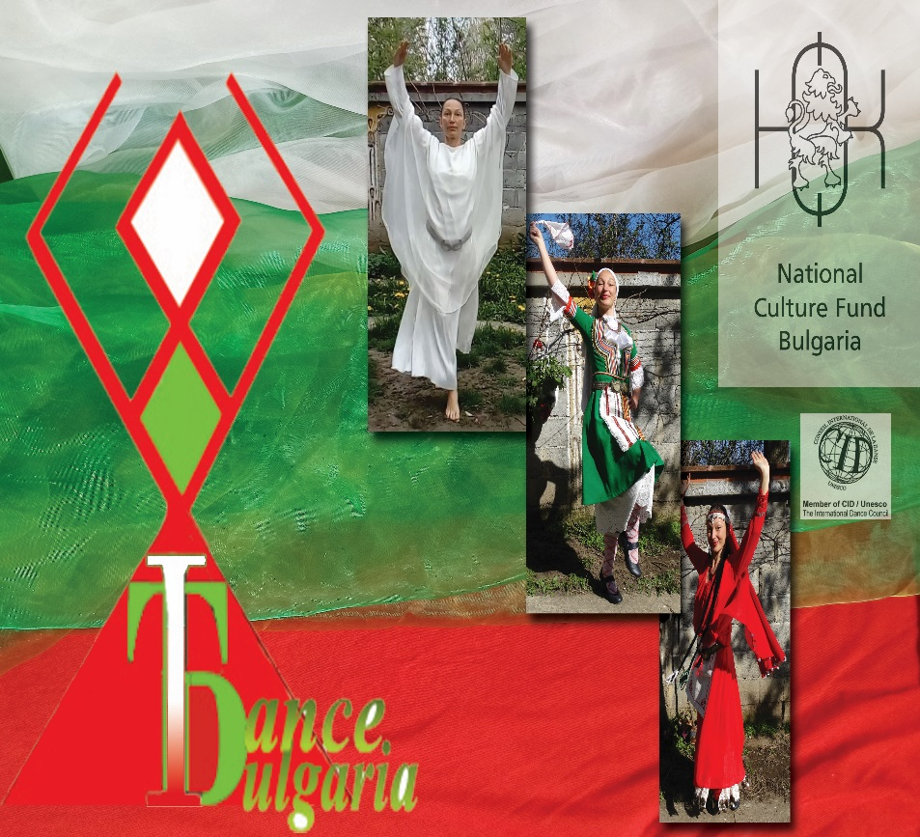
Current
Project:
https://dance-all.com/
“ I Dance Bulgaria - Knowledge Creativity Health
funded by Bulgarian National Fund Culture

Slide 3
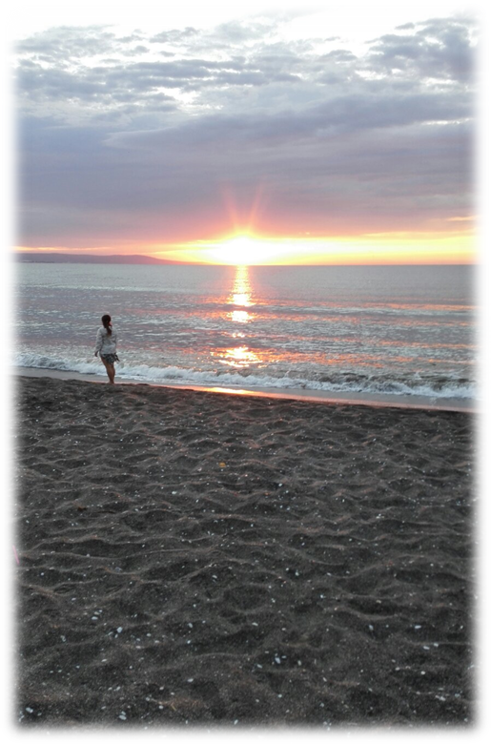
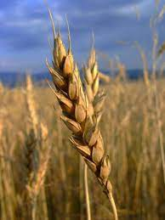
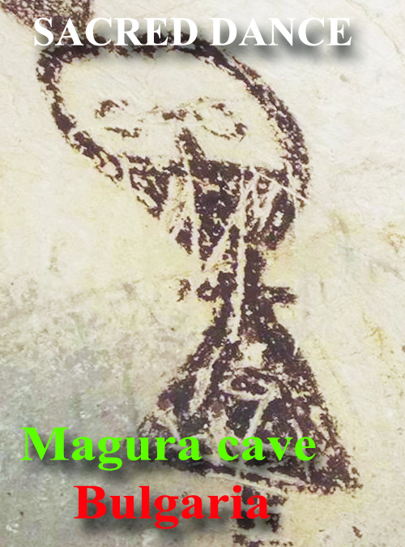
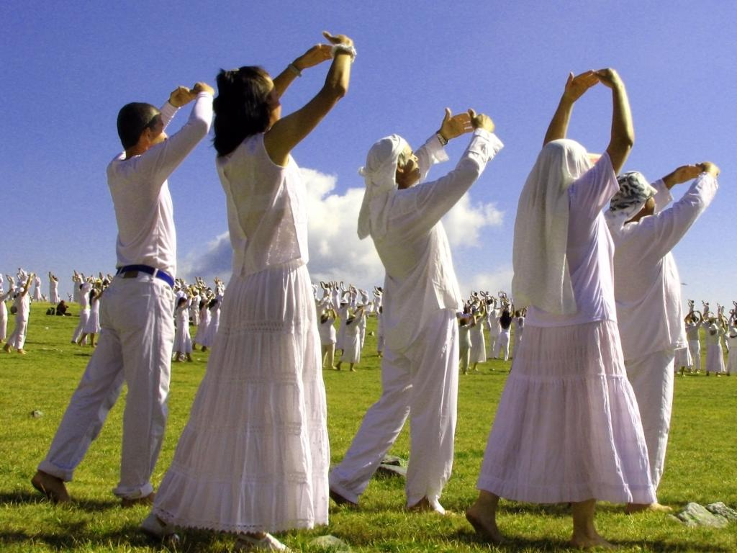
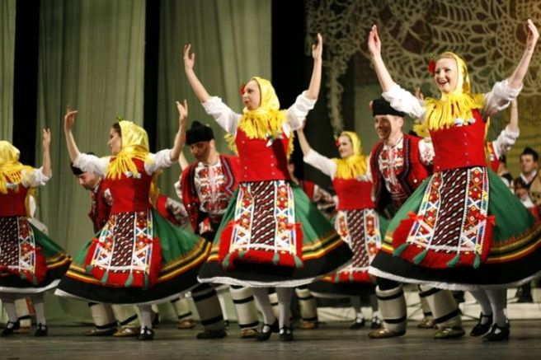
THE SUN – - worships, rites, powers, circle shapes and symbols are widely spread in the dance culture of the Bulgarians.
Magura cave Ensemble Dance PANEVRITMIA
North West Bulgaria (30 000-4000 BC) (Dobruja folk area) (Bulgaria 1922-1944)

Slide 4
The Bulgarian recreational method “Panevritmia” Sun rays – Rila mountain, 2019 Panevritmia leaded by Master Beinsá Dounó (1864-1944)

Slide 5
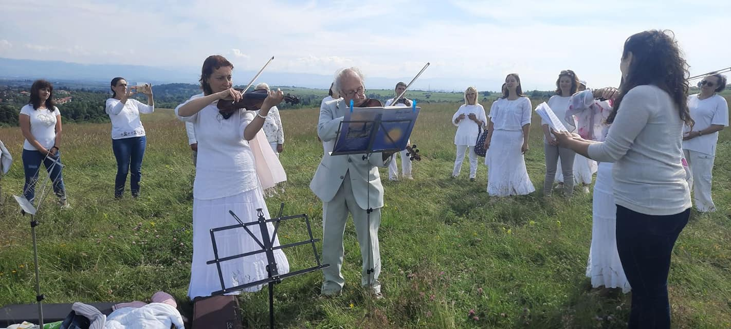
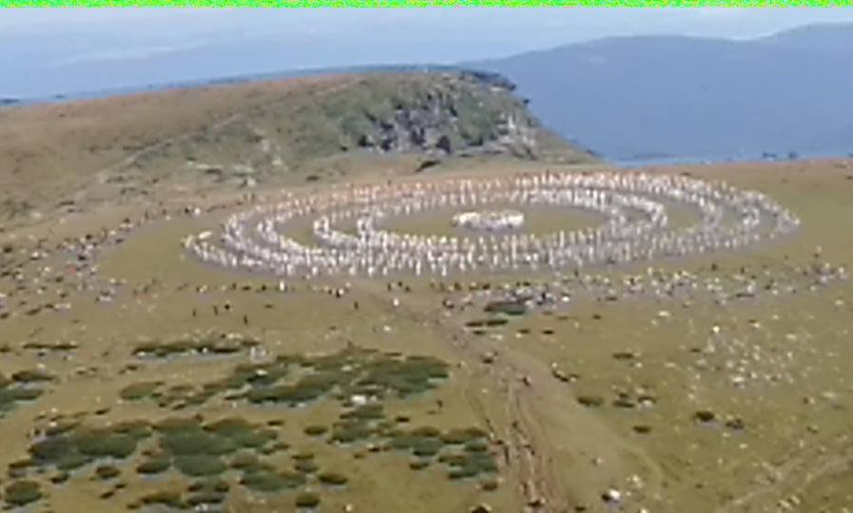
As its author says: “in harmony with the cosmical movements and rhythm which are creating, building and organizing the entire nature, that is why they have a powerful impact on the human.” Panevritmia (1938), p.66

Slide 6
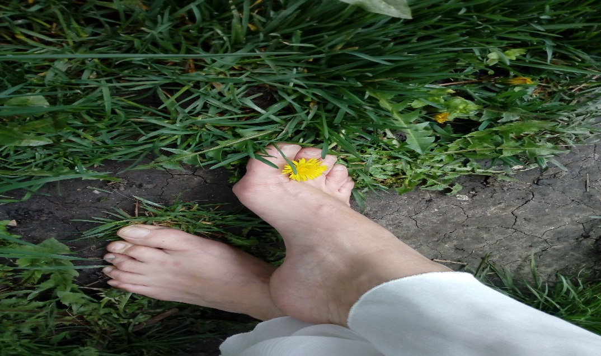
The Panevritmia is performed: - under the 1st “prana” or “orenda” charged sun rays- early morning and in open air spaces (green grass field, meadow or mountain peaks). - it is originally performed barefoot - In one of the last researches focused on the healthy impact Rojer Applewhite (2005) - his encephalogram survey and proves that the straight contact between electromagnetic fields of the Earth and human foot forms a defensive mechanism which can protect the modern human from the artificial electromagnetic fields in which he is submerged. - - body posture Panevritmia is observed in the medical science as “a model of movement activity” which improves the body posture, normalize the blood pressure, cholesterol levels, nervous system(Chervenkova 2013) 2013).
Dr. Iliana Petrova Salazar – Member of CID UNESCO
iliana.psdance@gmail.com

Slide 7
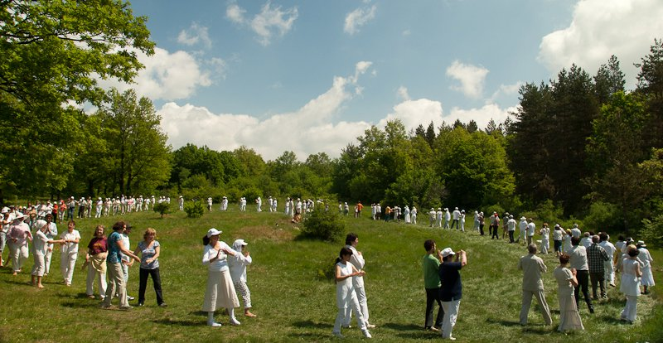
The “Panevritmia” has a proven healthy impact on the performers because of its total implementation of the trinity aspect – body-soul-spirit – dance - music - songs.

Slide 8
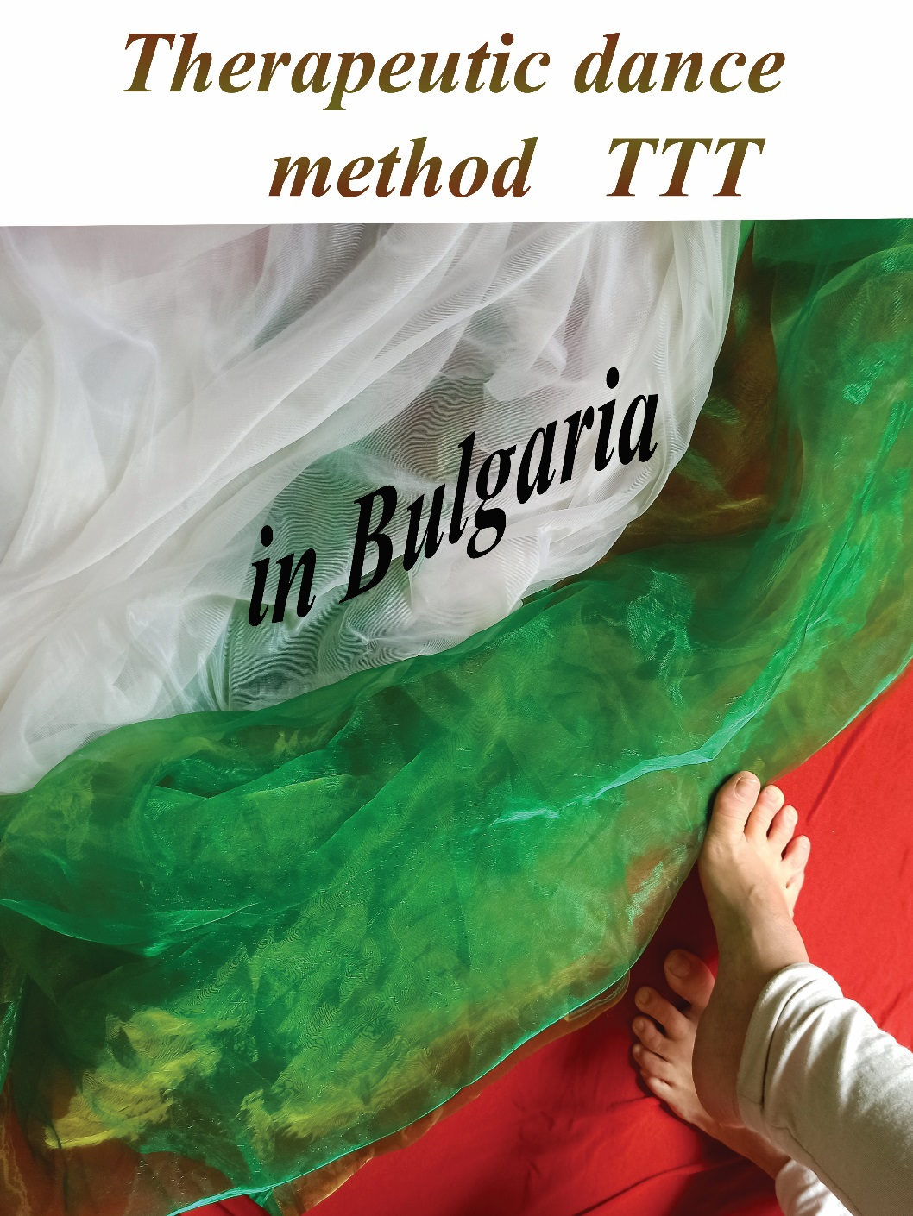
TRINITY TRANSFORMING TANZ - TTT
By Dr. Iliana Petrova Salazar

Slide 9
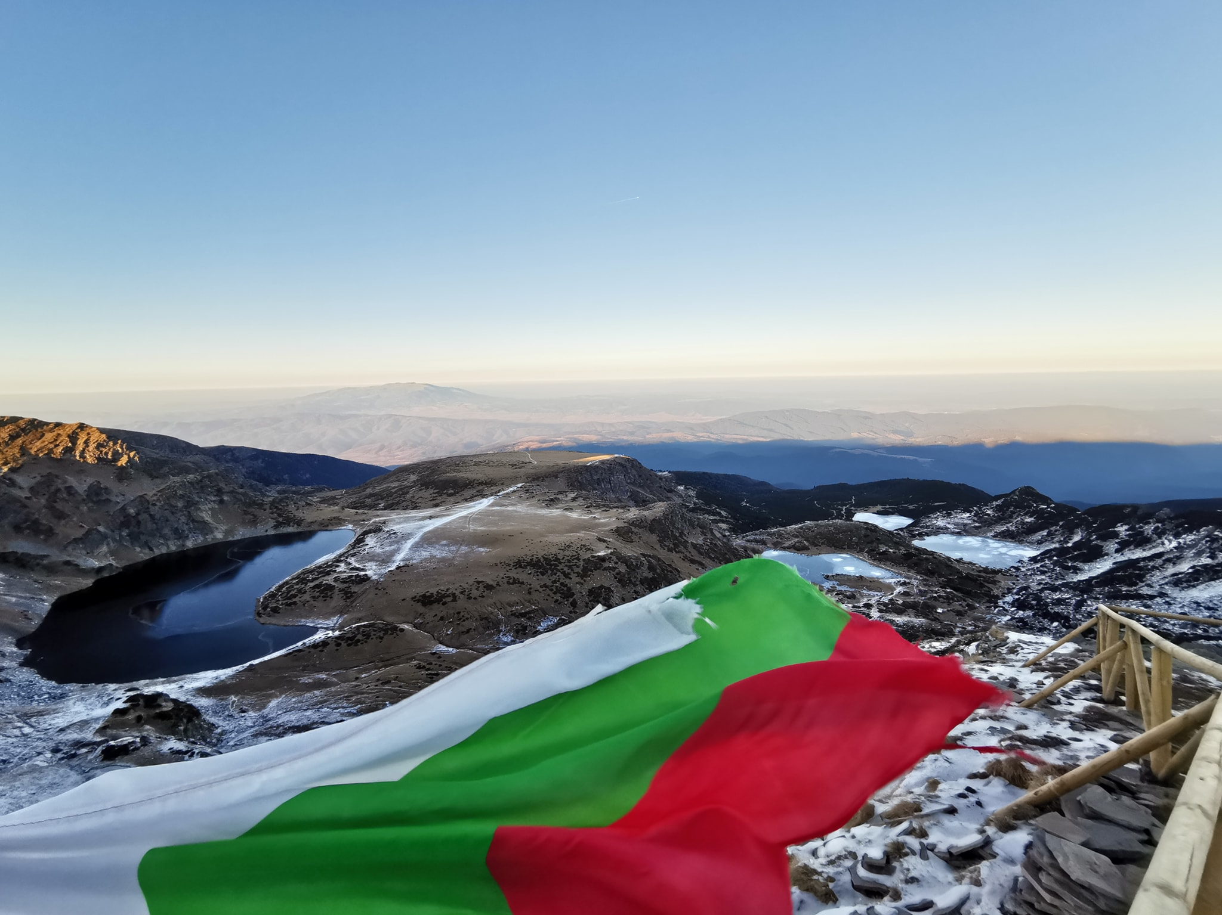
TRINITY TRANSFORMING TANZ – TTT method implemented the trinity model of Panevritmia by the Bulgarian flag:
RED
WHITE
GREEN

Slide 10
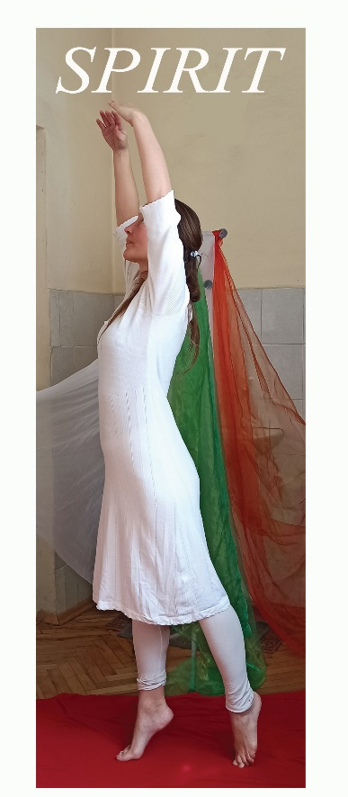
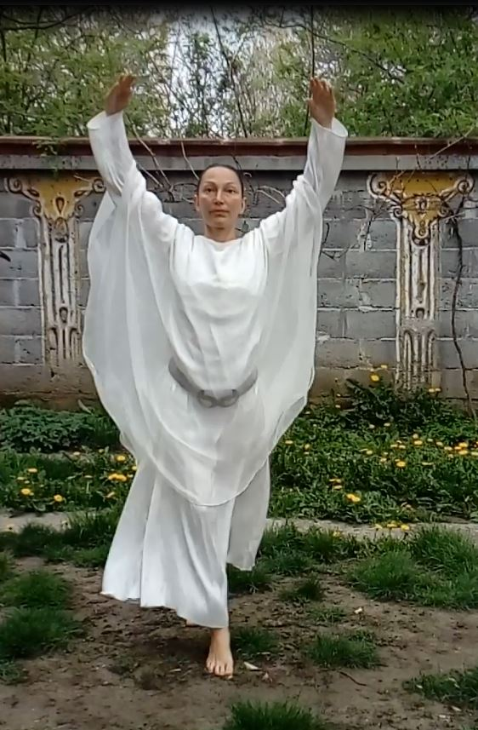
“TRINITY” – the awareness connection body-soul-spirit in Dance therapy (F.Levy, 1992; L.Espenak, 1981). WHITE color

Slide 11
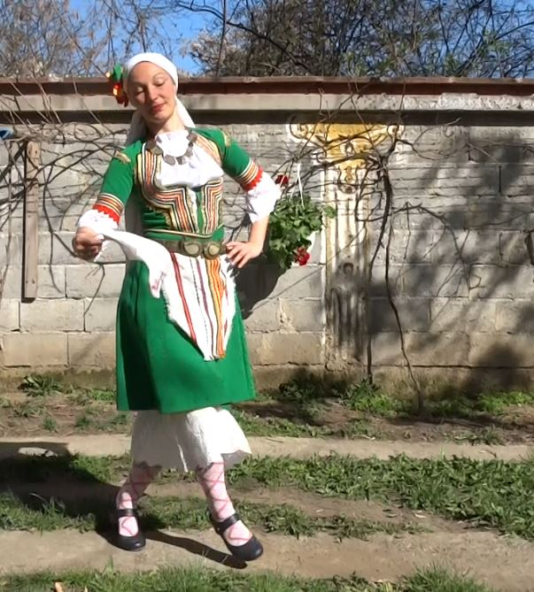
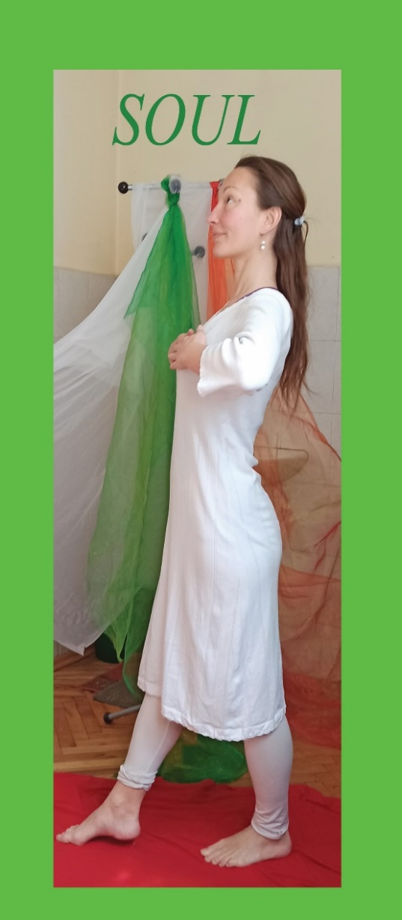
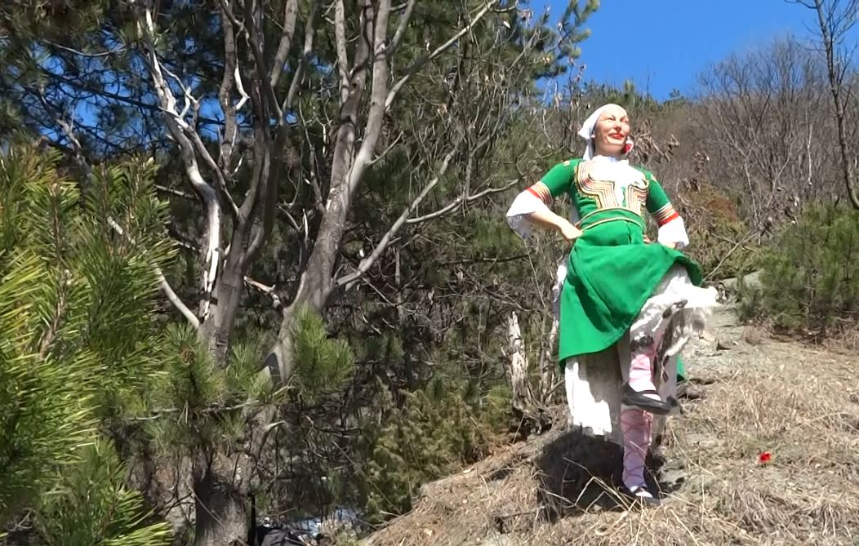
“TRANSFORMATION” – THE SOUL EXPRESIONS
GREEN color

Slide 12
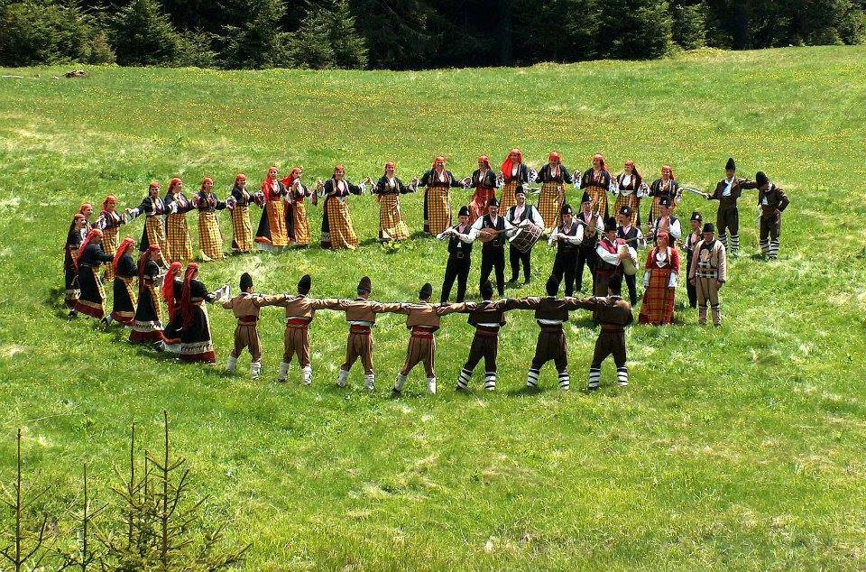
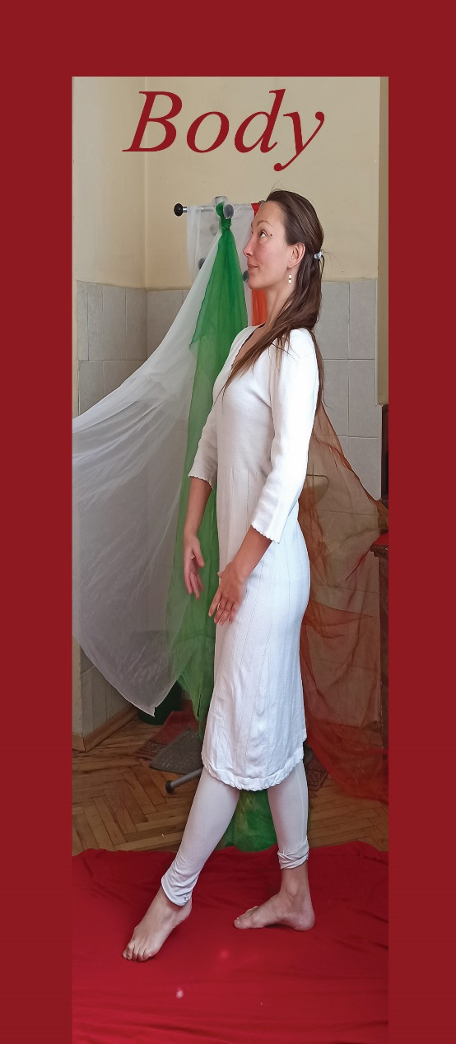
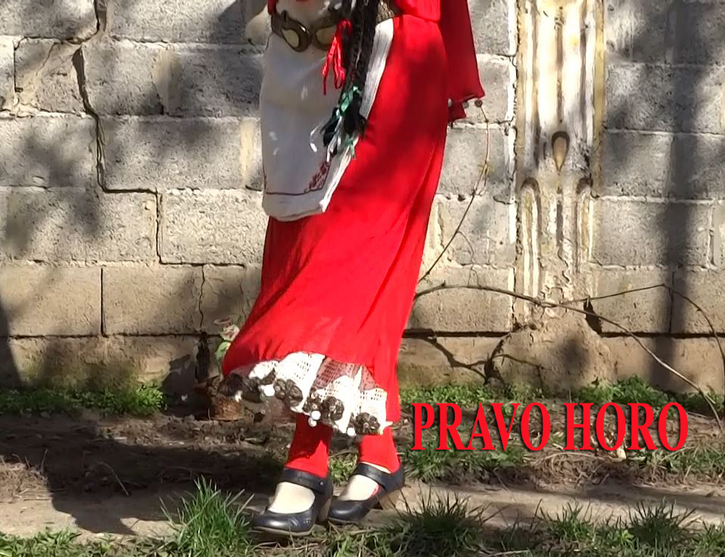
“TANZ / DANCE” – the physical implementation
RED color

Slide 13
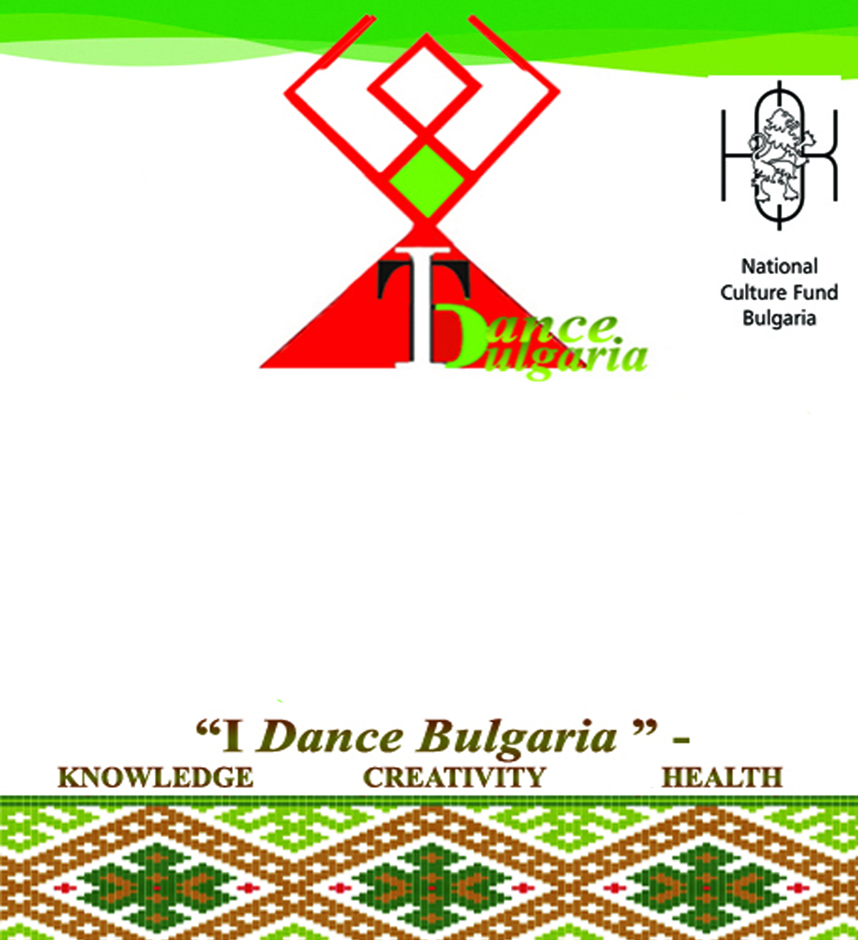
Triune aspects TTT See more: https://dance-all.com/ https://therapy-dance.weebly.com/
White
Green
Red

Slide 14
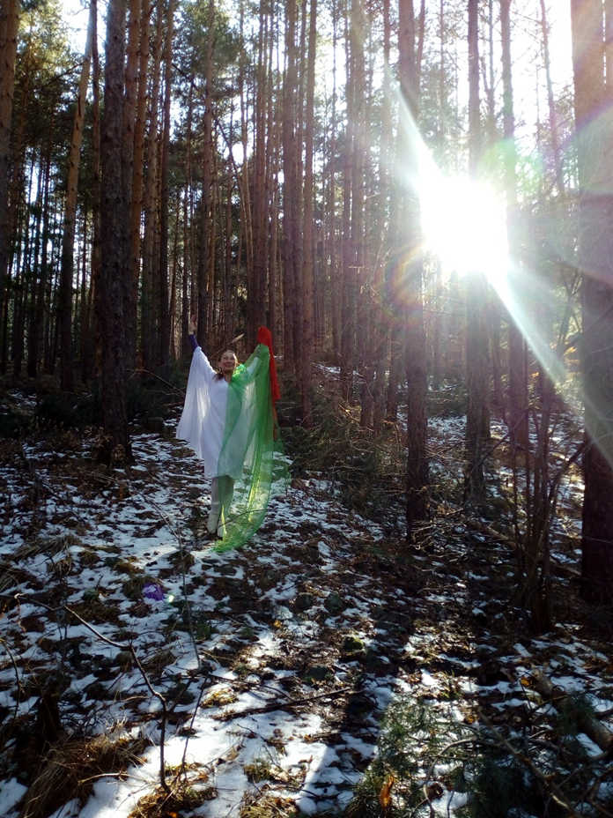
This presentation is made with the kind cooperation of:
Thank you for your kind attention!
https://therapy-dance.weebly.com/ iliana.psdance@gmail.com
National Fund Culture Bulgaria
National school art institution ”Acad. Andrei Stojanov-2003” , Sofia
Photography & Video: Katerina Krasteva, Stefi Rumenova, Tania & Ecaterina Co.

