Slide 1
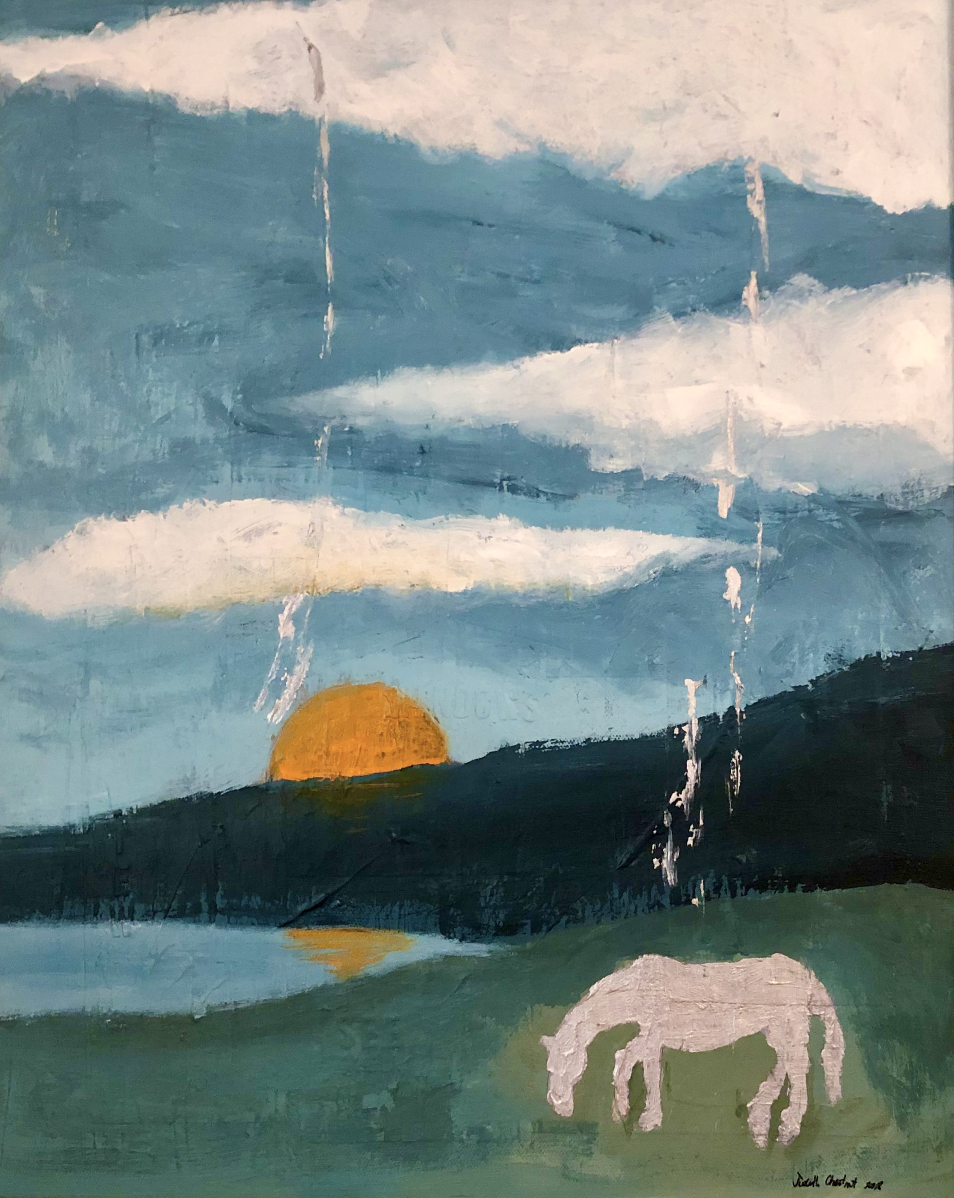
Nature and Dance
Dancing with horses in nature

Slide 2
Introduction
My name is Judith Chestnut and I have been a Member of the International Dance Council since 2003. I live in Australia with my family and regularly ride my horse, Montana in the dressage arena at Blue Gums Equestrian, a horse-riding school situated close to my home.

Slide 3
Dancing with horses in nature
I have the pleasure of being with Montana nearly everyday; rain, hail or shine. When we are together on the arena going through our paces it is to my way of thinking, the same as dancing.

Slide 4
Safety first
Horse-riding is not without risk. However, every ride is guided by a researched training system that has rider and horse safety at the forefront of its methodology.

Slide 5
Daily routines
The methodology builds on the natural ways of horses and how their temperaments are best served through well considered daily routines and exercises both in hand and under saddle.

Slide 6
The bigger picture
Being involved with horses in nature is a continual learning experience. The welfare of the horse must be considered as part of the bigger picture of the world-wide consideration for animal welfare in general. Veterinarians, farriers, trainers and coaches are all part of this bigger picture and are called upon regularly for their expertise and services.

Slide 7
Inspiration for the dance
From a dancer’s point of view, being involved with horses means that you are dancing with a partner ten times your own body weight. This partner requires confident and clear directions and has a limited attention span. This partner also has the capability to move with rhythm and grace, and it is those elements that inspire the dance.

Slide 8
dressage
For me, the choreography for the dance is based on the recognizable movements through the patterns and figures of classical dressage. The history of dressage can be traced back to Xenophon’s book, The Art of Horsemanship. Today, people of all ages in many countries, practice these movements with their horses.

Slide 9
When we dance
Australia’s first Grand Prix Dressage rider, Tina Wommelsdorf stated that;
The exquisite feeling of being one for more than a glorious moment, you may only achieve in Dressage, when you are dancing to the song of wind and sun, free of gravity, far away in a world of your own.
It is like that when Montana and I are moving across the dressage arena with rhythm and grace. It is then we are dancing in nature.

