Slide 1
Dance and Disability in Bosnia and Herzegovina
Ivana Hadžihasanović, Phd –
Director of Organization Tanzelarija
Dance and disability teleconference - CId
Sarajevo, 24.9.2022.

Slide 2
Place of Dance in Bosnia and Herzegovina
Ballet schools
Contemporary dance studios
National Theater – Classic Ballet

Slide 3
Place of people with disability in art
In four classic ballet schools in B&H only one child with disability is implemented (deaf child)
Dance theaters do not include artists with any kind of disability
Art projects which include this population

Slide 5
Tanzelarija – Dance and Disability
From 2018. we started to work with deaf children in pilot project
This project was intended to develop new way of dance teaching
We worked with 30 deaf children age from 7-15
Today we call this method “Silent Dance”

Slide 6
Silent Dance Method of teaching
This method engage two faces:
First face is rhythmic stimulation: Inner rhythm and movement on rhythm
Second face is learning dance technique
Third face is putting learned technique in rhythm

Slide 11
Ballet phraseology on sign language
In purposes for teaching dance technique we developed ballet phraseology on sign language.

Slide 13
Silent Dance Company
In February 2022, we founded youth contemporary dance company that includes youth from dance schools hearing and deaf and deaf youth who had dance education through our program.
Today, there is engaged 20 youth age from 13-18, and four of them are deaf.
We had premier of our first production “Another me” in Jun, 2022.
Now we are dancing this piece and preparing another one, which premier we expect in December.

Slide 17
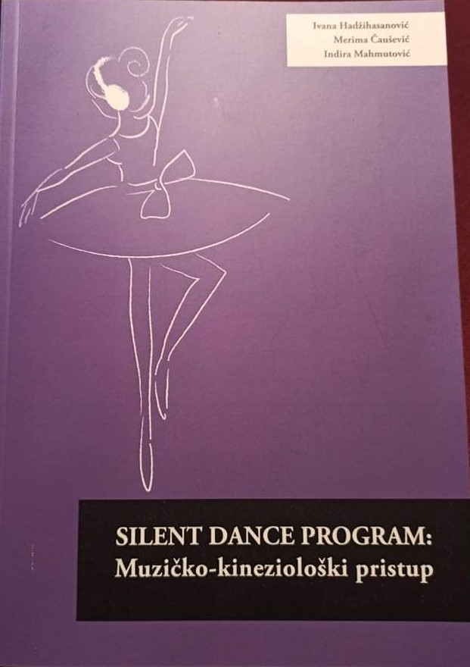
Silent dance - Book
Silent Dance Program: Music-Kinesiological Aproach

Slide 18
Thank you! www.tanzelarija.eu

