Slide 1
Historical dances
A selection of prints and paintings from the Dance History Gallery, curated by Alkis Raftis
Presentation by Alessia Vescovini - CID Management Assistant Music: Luigi Boccherini: Minuetto

Slide 2
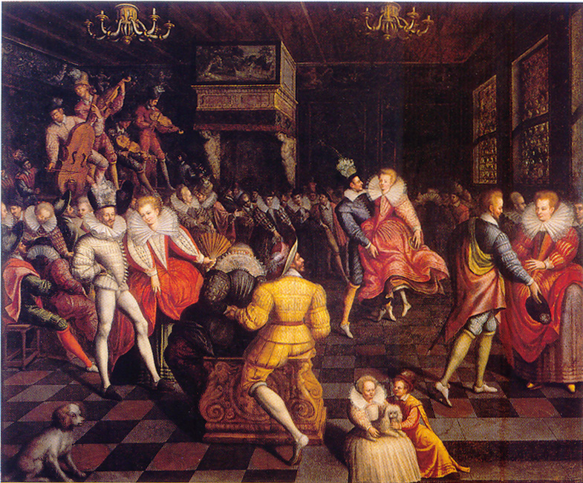
“Marguerite de Valois dancing the volta at the court of Valois”
-
ca. 1580
Painting
Notes:
s3980 France. couple, volta, court

Slide 3
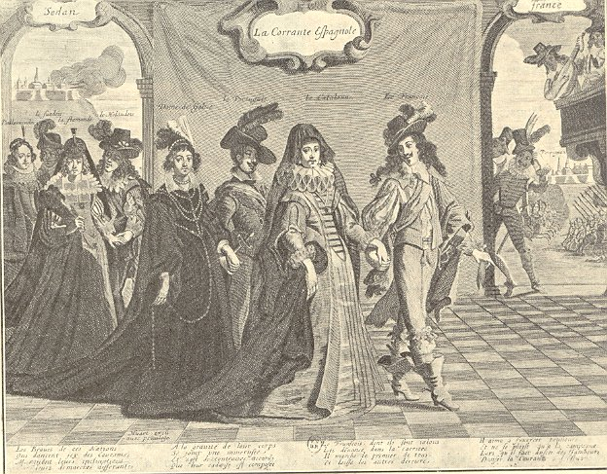
“La Corrante Espagnole dance”
-
1643
Print
Notes:
s2933 Print published on the occasion of the fall of Perpignan, as a parody of the victory of France over Spain
France, Spain. court, couple, courrante

Slide 4
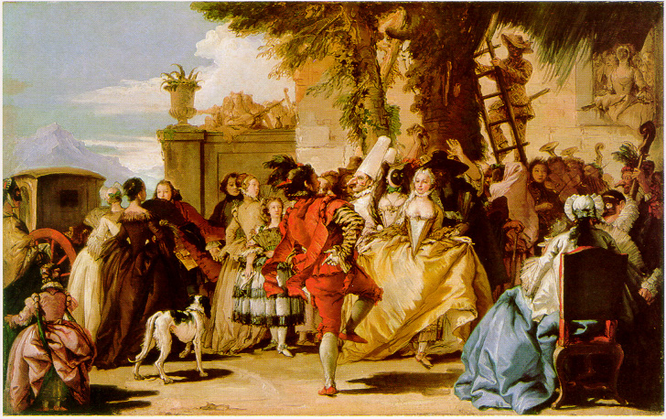
“A dance in the country” - Giandomenico Tiepolo, ca. 1750
Painting, oil on canvas
Notes:
p2227 Italy, popular dance

Slide 5
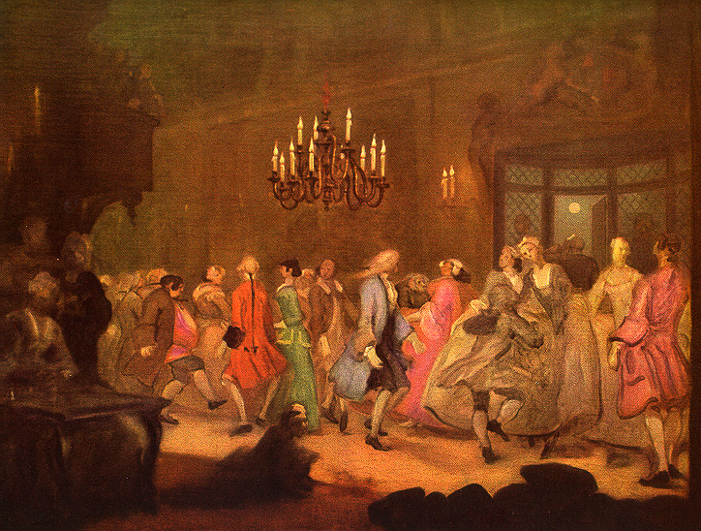
“The Wanstead Assembly”
-
William Hogarth, ca. 1750
Painting
Notes:
p5746 UK ballroom

Slide 6
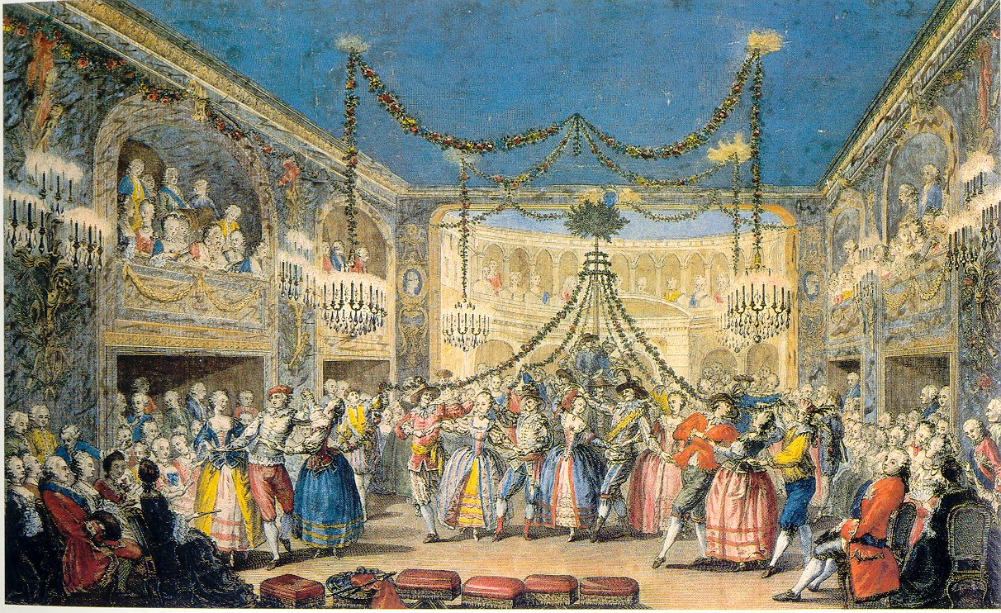
“A May ball given in Versailles during carnival of the year 1763”
Gabriel de Saint-Aubin, 1764
Print, color
Notes:
s2781 Versailles. traditional, popular

Slide 7
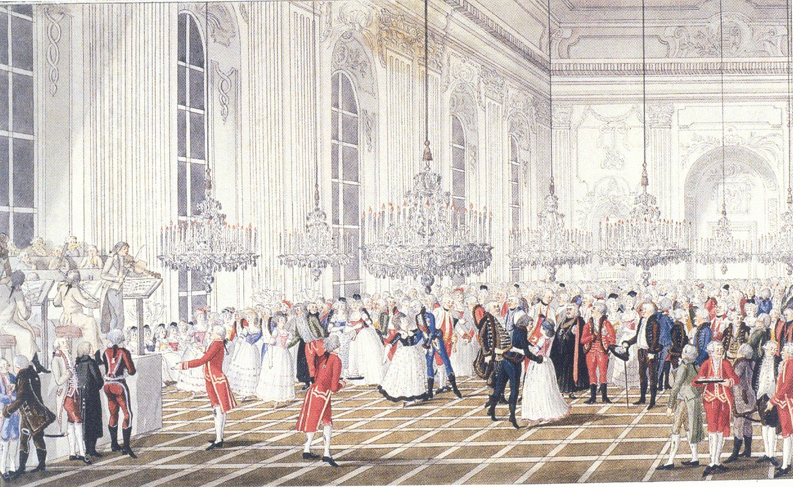
“Grand ball at His Royal Highness the Palatine’s Palace” - József Pollencig, 1795
Drawing, watercolor and gouache on painting
Notes:
p4848 Hungary, Buda. ballroom

Slide 8
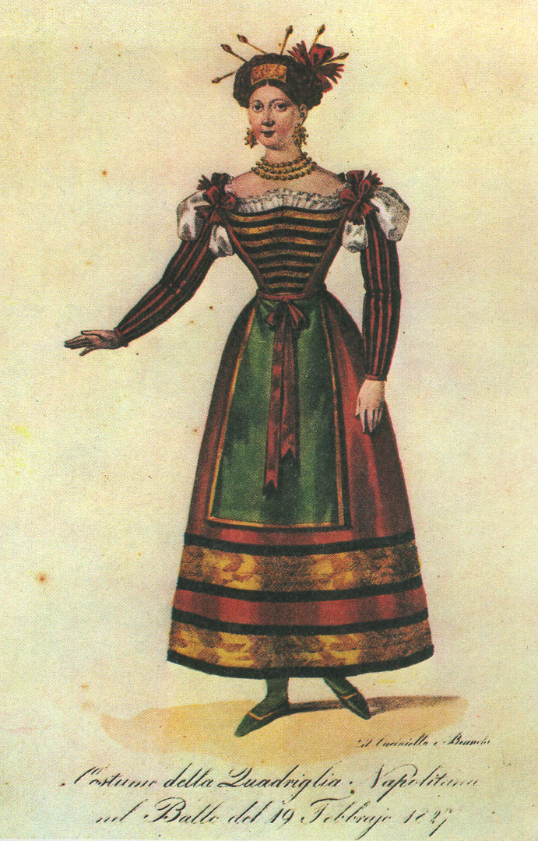
“Costume of the Neapolitan quadrille
in the ball of 19/02/1827”
-
ca. 1830
Print
Notes:
s0540 Naples quadrille

Slide 9
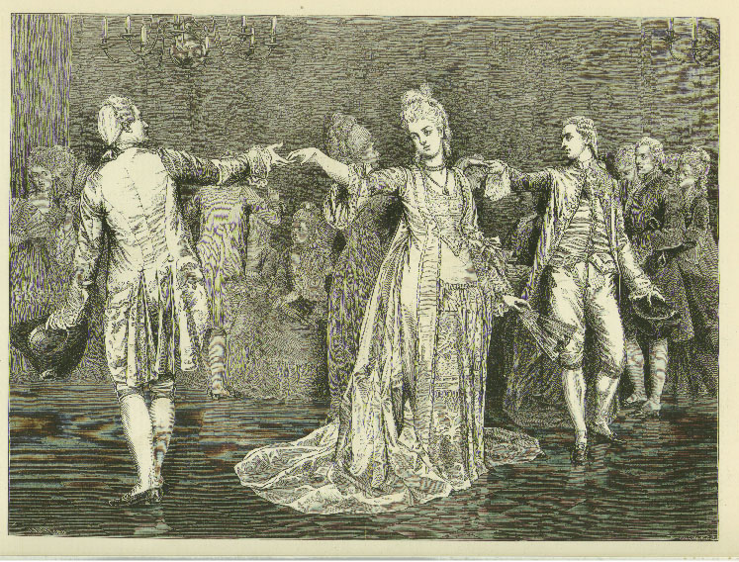
“A minuet”
-
Valentin Cameron Prinsep, 1875
Print
Notes:
s0777 from a painting exhibited in the Royal Academy, London. UK. Minuet, court.

Slide 10
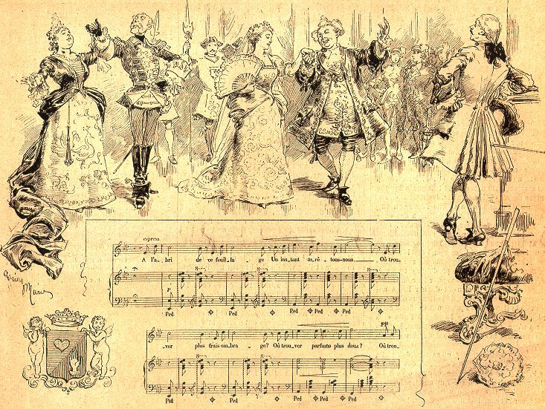
"Heart and hand, comic opera. Melody of act 1, sung by Mrs. Vaillant-Couturier”
-
Adrien Marie, 1882
Print
Notes:
s0661. Paris. Court, ballroom, couple

Slide 11
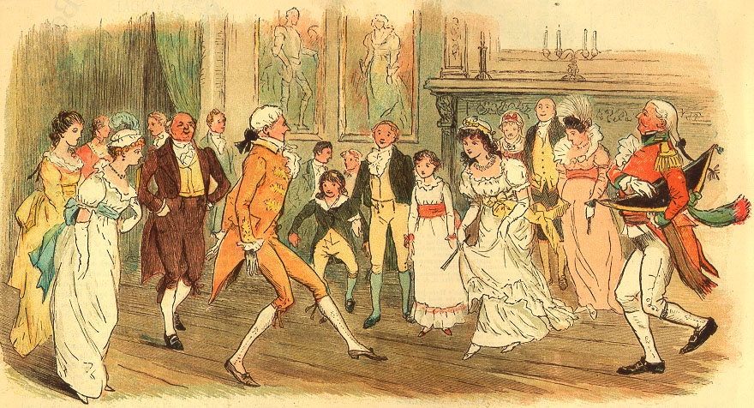
“Such a collection of relatives we had for a dance that evening - oh, how old-fashioned he must have thought us.” - 1883
Illustration for a short story
Notes:
s0684 UK. Popular, ballroom

Slide 12
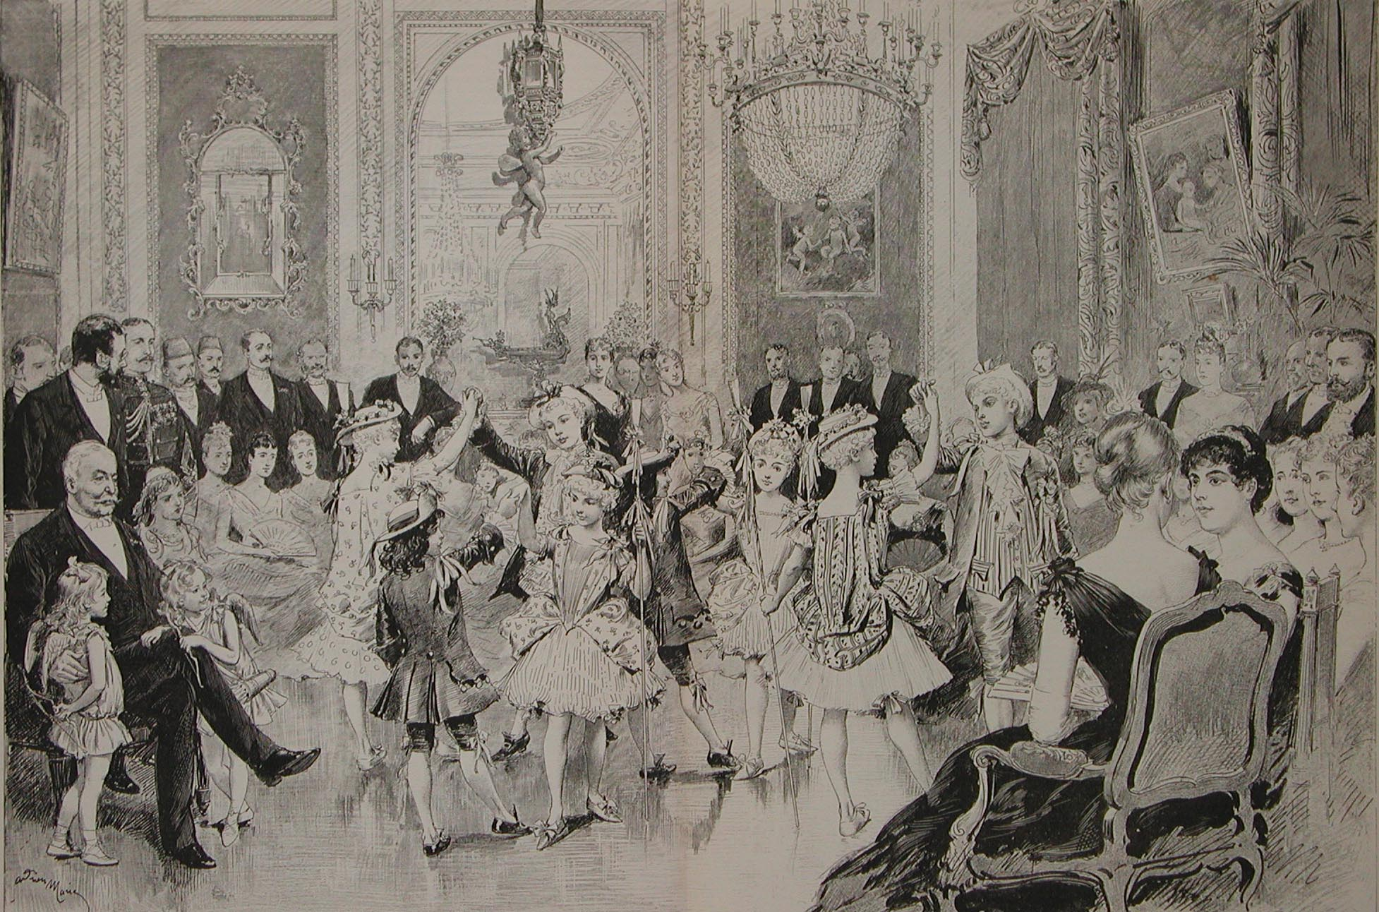
“The salon of Mr de Lesseps on the day of mid Lent - The children dance the minuet” - Adrien Marie, 1887
Print, monochrome
Notes:
s2550 Paris. popular, historical.

Slide 13
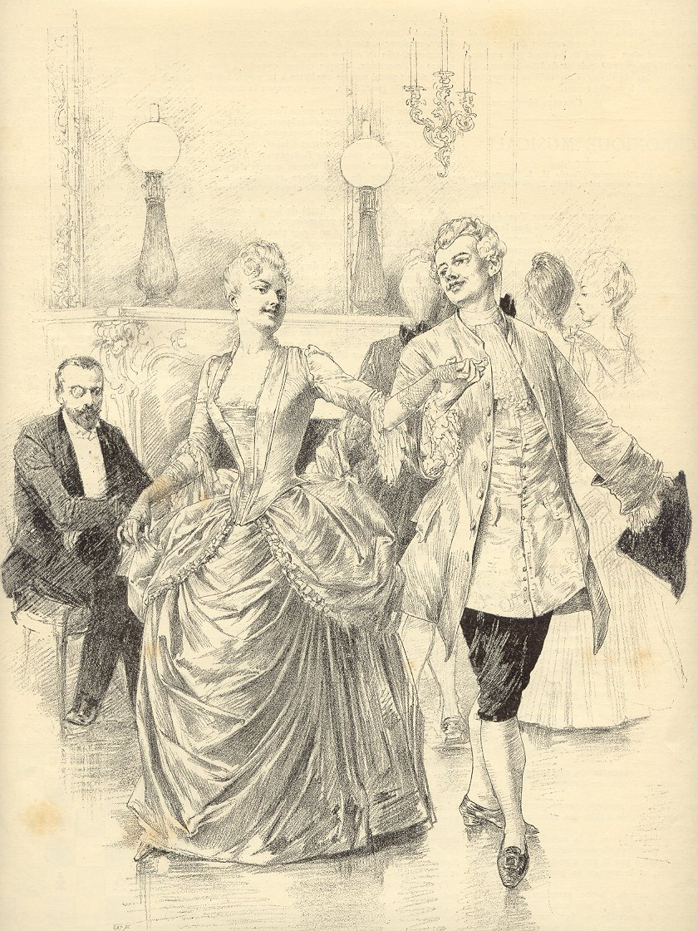
“Before the ball - General rehearsal of the minuet in disguise”
-
Stanisław Rejchan (or Reichan), 1887
Print, monochrome
Notes:
s2552 paris. minuet

Slide 14
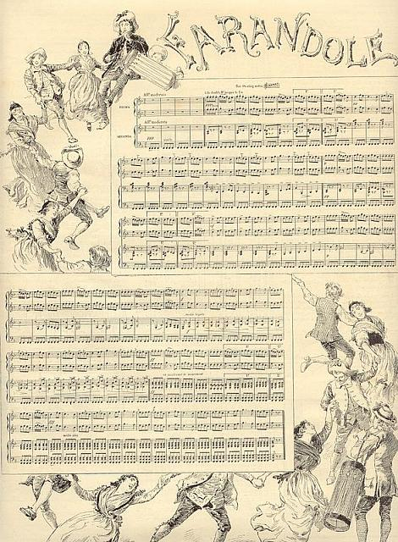
“The Farandole, for the piano, by four hands, by Claudius Blanc and Léopold Dauphin”
-
Adrien Marie, 1887
Print, monochrome
Notes:
s2553 France. Farandole, traditional, line.

Slide 15
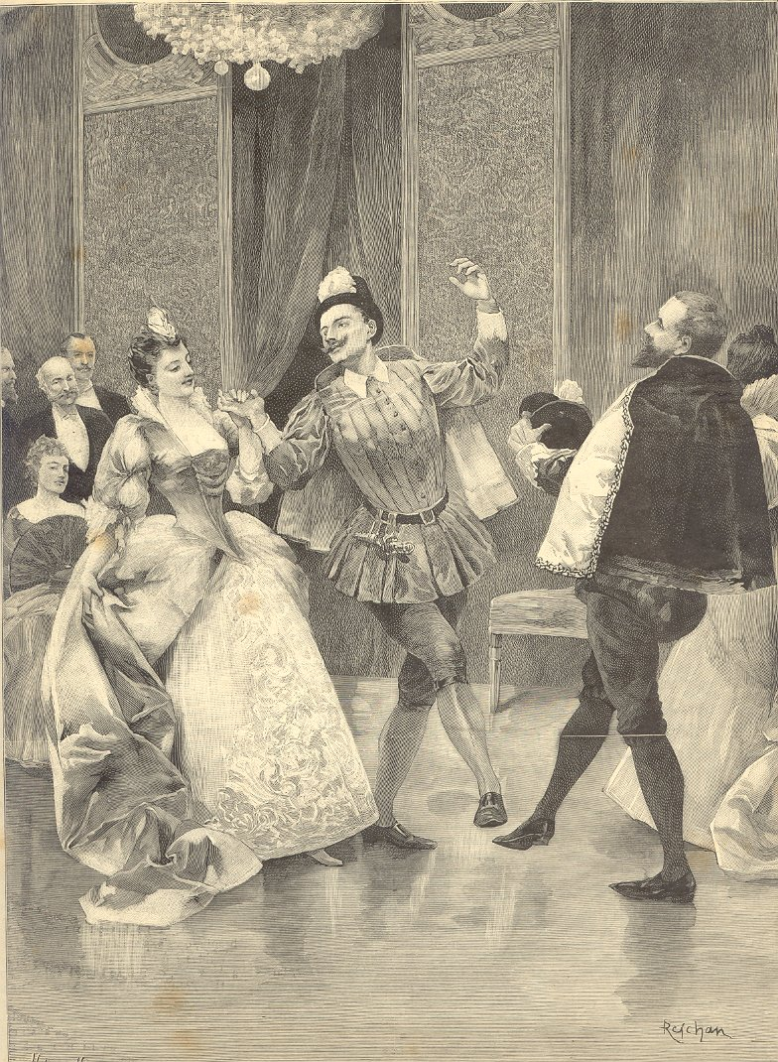
“Mid-Lent. La Pavane, dance at the costumed ball”
-
Stanisław Rejchan 1888
Print
Notes:
s2561 France. court.

Slide 16
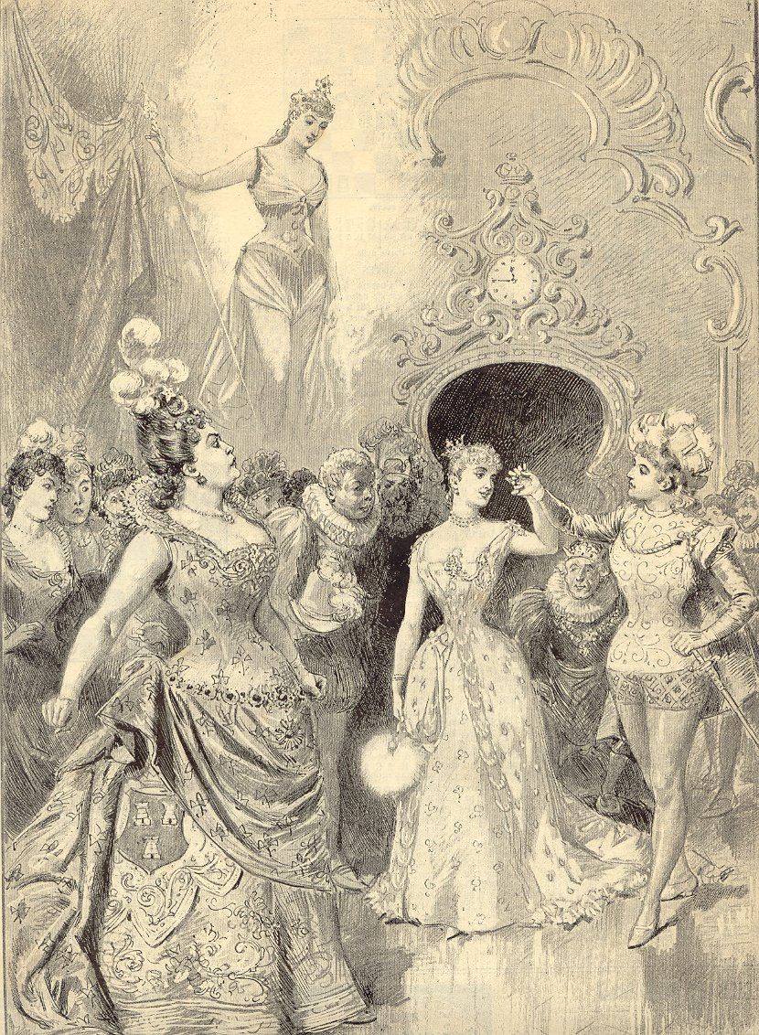
“Châtelet Theatre: "Cinderella” - Ball at the royal court”
-
Adrien Marie, 1888
Print
Notes:
s2562 France. court.

Slide 17
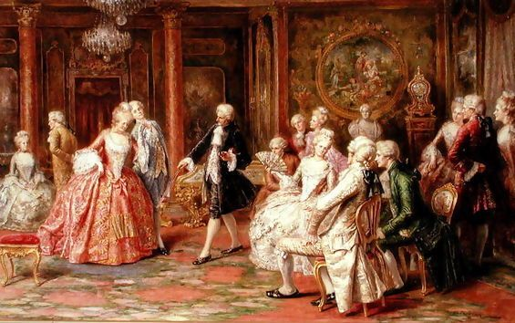
“The waltz” - Angelo Zoffoli, ca. 1895
Painting
Notes:
s5405. waltz, couple.

Slide 18
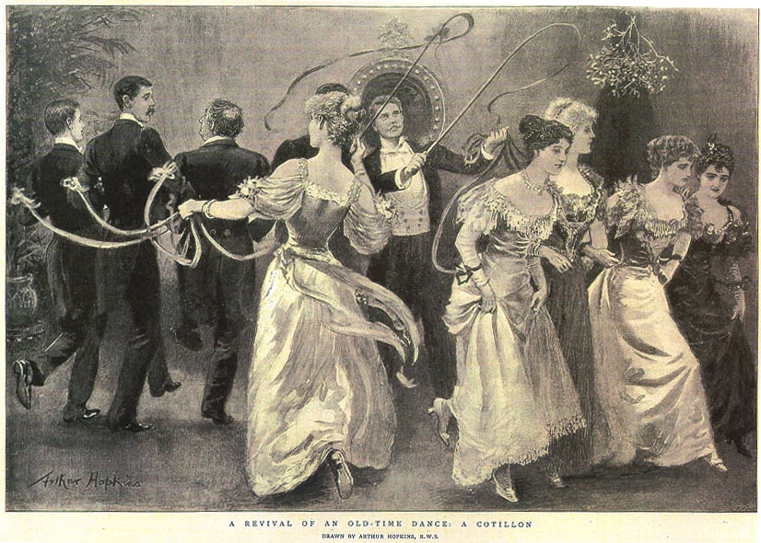
“A revival of an old-time dance: a cotillon”
Arthur Hopkins
1897
Print
Notes:
s0848. UK. Ballroom, popular, mixed

Slide 19
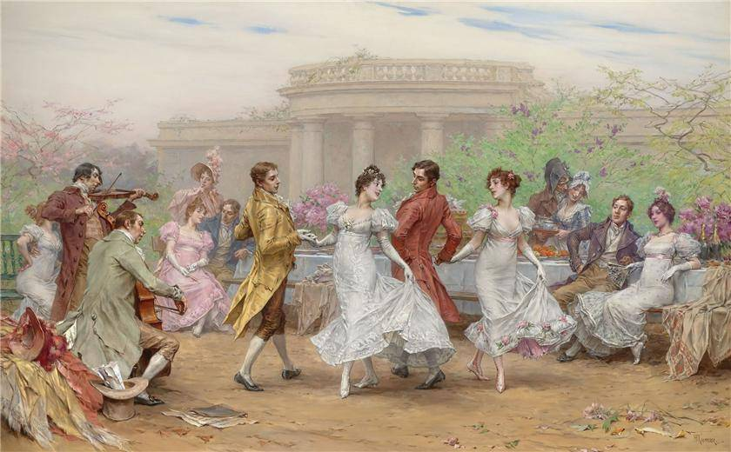
“Dance scene” - Cesare-Auguste Detti, ca. 1900
Painting
Notes:
s5448 Italy. court.

Slide 20
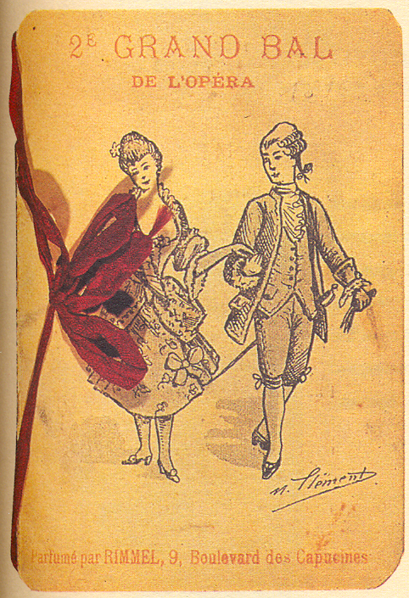
“2e Grand Ball de l'Opéra. Parfumé par Rimmel, 9, Bd des Capucines”
-
M. Clément (drawing), 1925
Print, color, card
Notes:
s4669 Paris. couple, court

